Slide 1
7C
A NIGHT TO REMEMBER

Slide 2


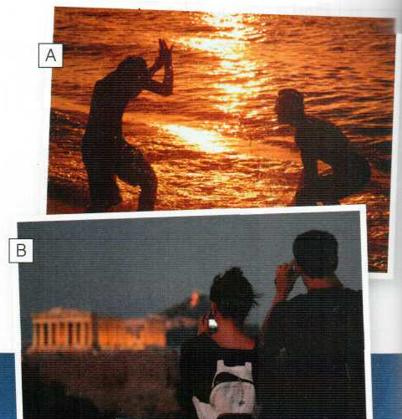
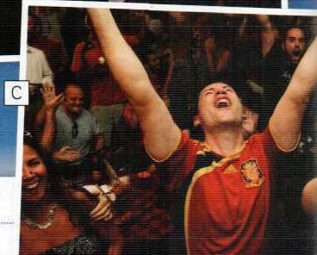
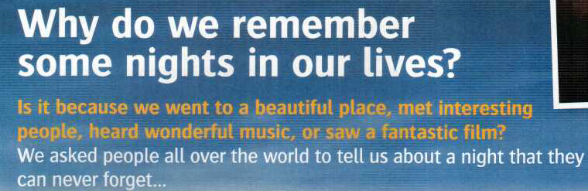
Why was the night memorable?

Slide 3
go- went
meet- met
hear- heard
see- saw
ask- asked

Slide 4
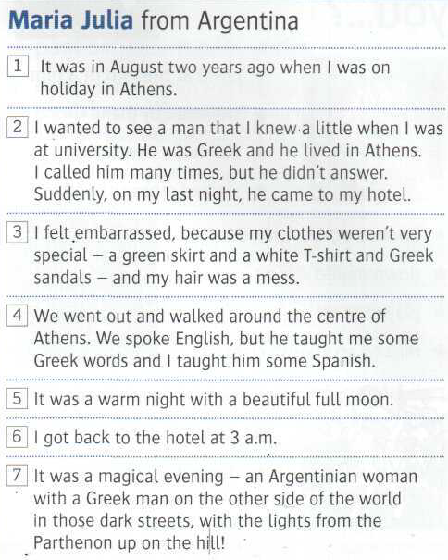
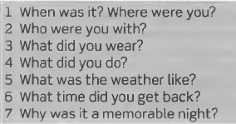
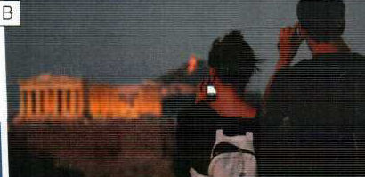
00.18
Page 56
Know-knew
come-came
feel-felt
go-went
speak-spoke
teach-taught
get-got

Slide 5
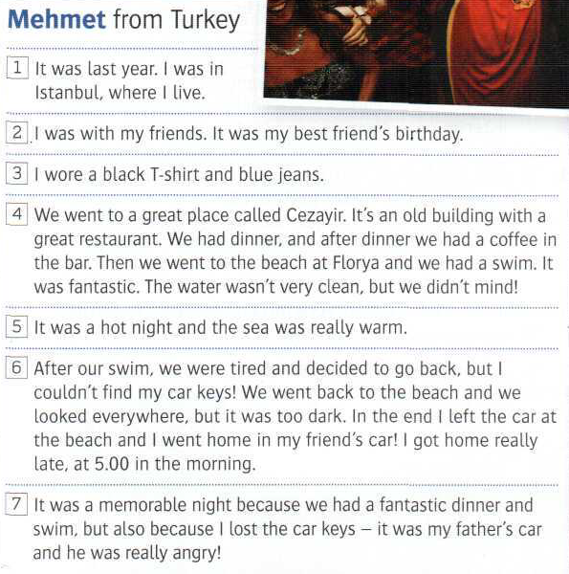
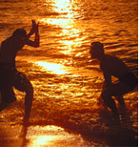
1.23
wear-wore
go-went
have-had
leave-left
lose-lost
1.22

Slide 6
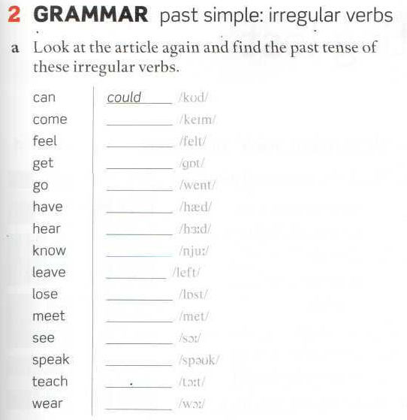
came
Page 57
felt
got
went
had
heard
knew
left
lost
met
saw
spoke
taught
wore

Slide 7
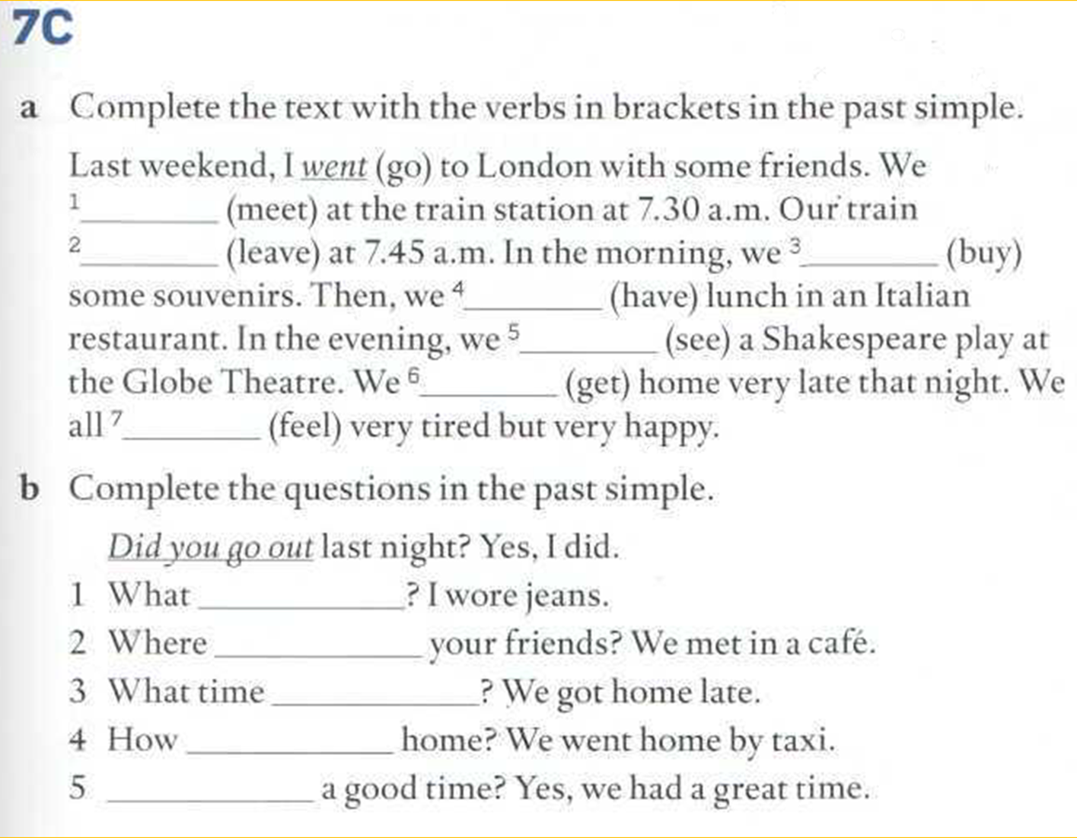
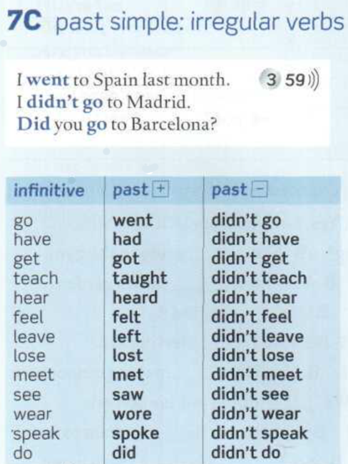

Slide 8
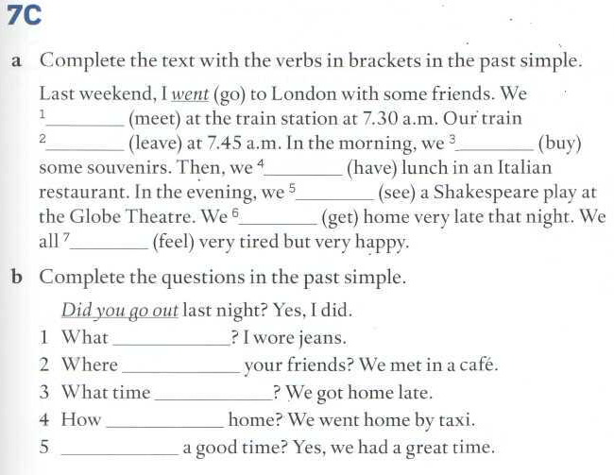
met
left
bought
had
saw
got
felt
did you wear
did you meet
did you get home
did you go
Did you have

Slide 9
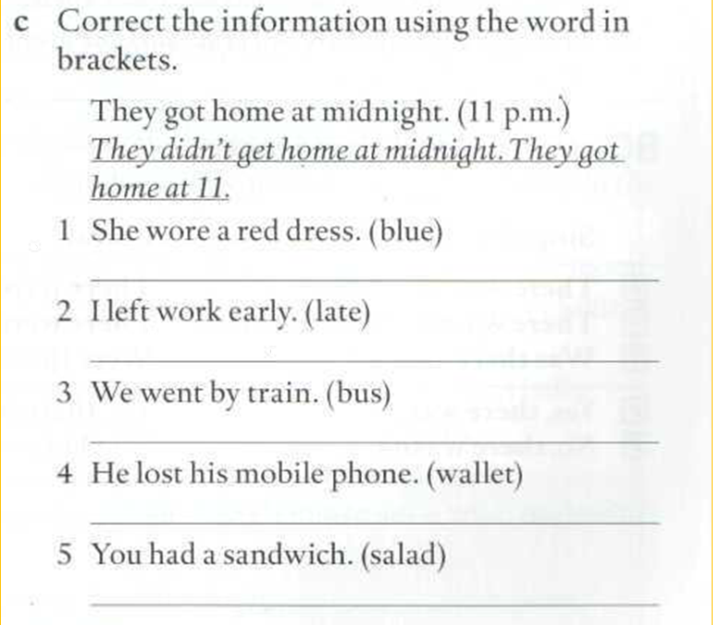
She didn’t wear a red dress. She wore a blue dress.
I didn’t leave work early. I left work late.
We didn’t go by train. We went by bus.
He didn’t lose his mobile phone. He lost his wallet.
You didn’t have a sandwich. You had a salad.

Slide 10
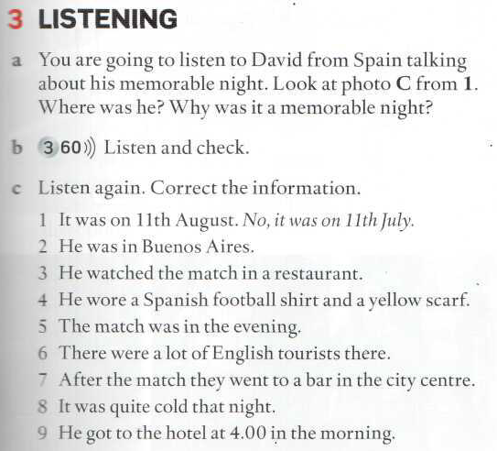
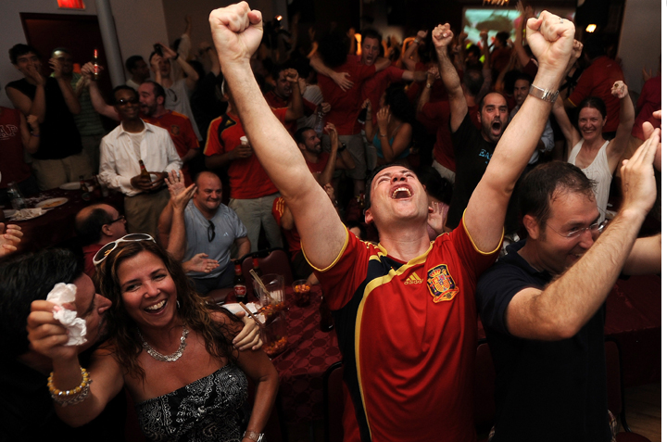
He wasn’t in BA. He was in Acapulco, Mexico
He didn’t watch the match in a restaurant. He watched the match in the hotel bar.
He didn’t wear a yellow scarf. He wore a red and yellow scarf.
The match wasn’t in the evening. It was in the afternoon.
There were a lot of Spanish tourists. The tourists weren’t English, they were Spanish.
They went to a bar near the beach. They didn’t go to a bar in the city centre.
It was not cold, it was warm.
He didn’t go to the hotel at 4 in the morning, he went to the hotel at 3.

Slide 12
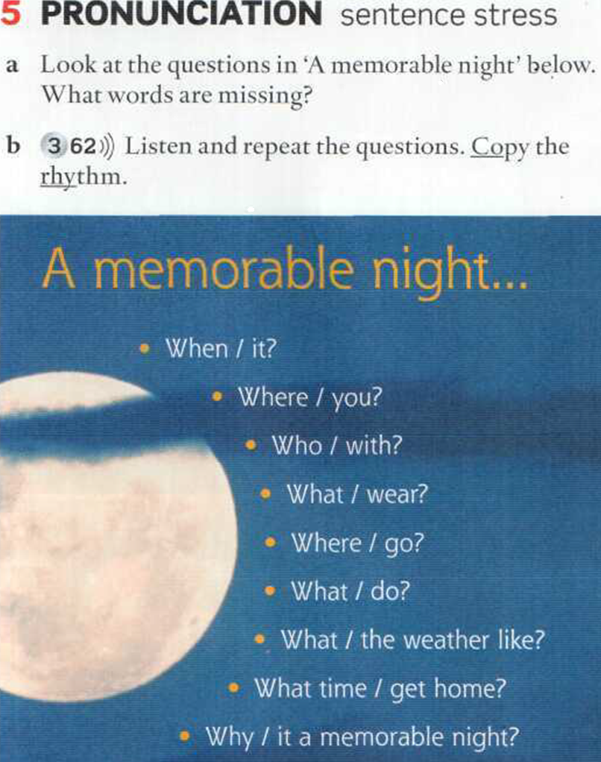
When was it?
Where were you?
Who were you with?
What did you wear ?
Where did you go?
What did you do?
What was the weather like?
What time did you get home?
Why was it a memorable night?

Slide 13
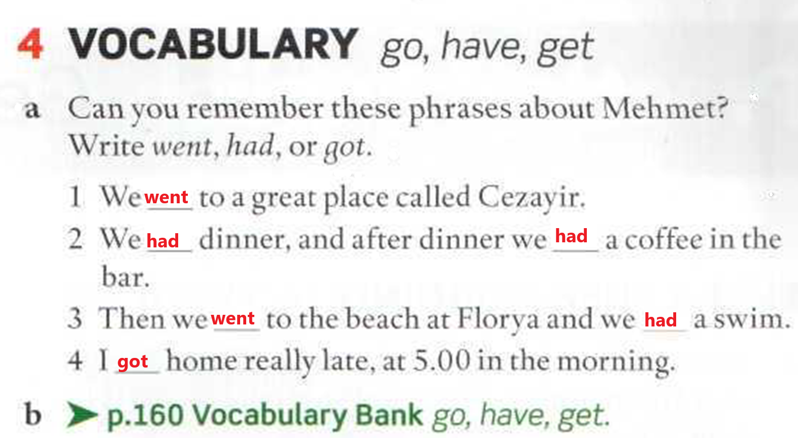

Slide 14
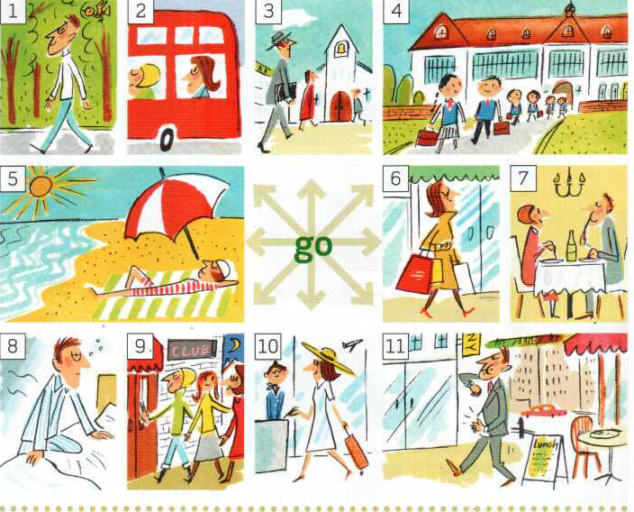
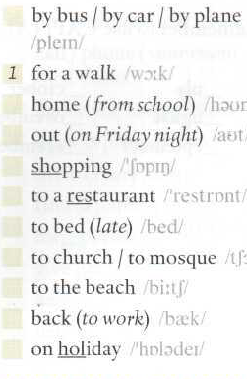

Slide 15
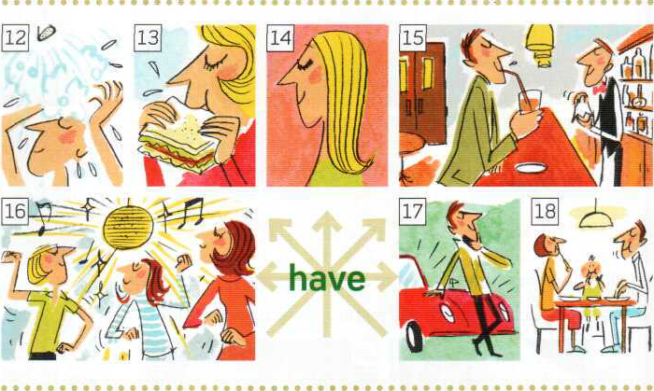
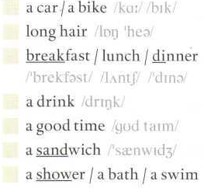

Slide 16
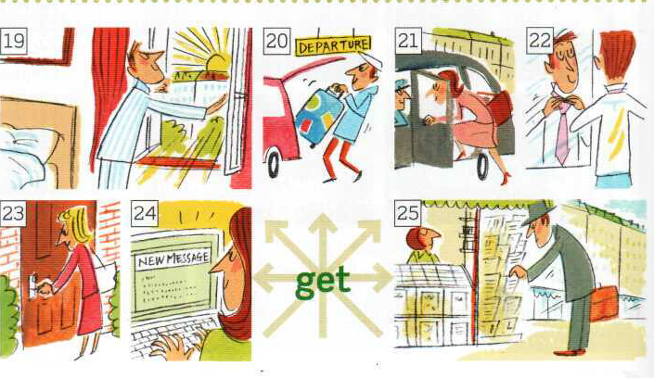
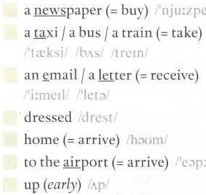

Slide 17
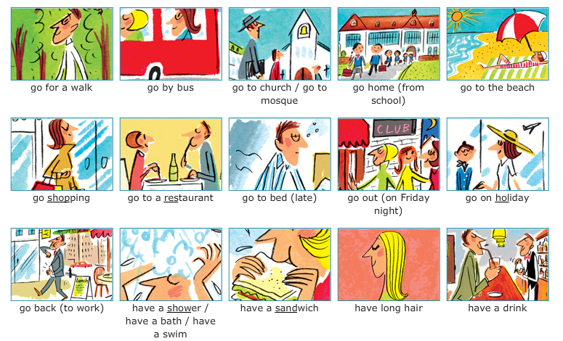

Slide 18
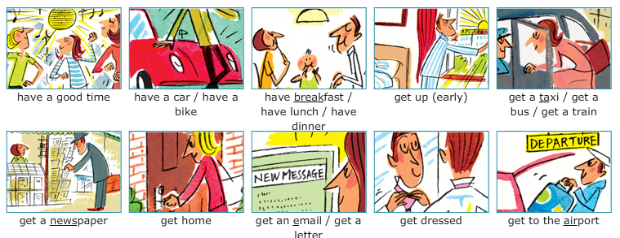

Slide 19
IRREGULAR VERBS
Is/am Are Come Say Speak Sit Go Sleep Hear See Think Read Get up Have Take find | Was Were Came Said spoke Sat Went Slept Heard Saw thought Read Got up Had Took found
Study the meanings of these irregular verbs

Slide 20
PRONUNCIATION OF -ED
/d/ | /t/ | /id/
Arrived died | looked asked | hated visited
Killed followed | finished pushed | started texted
Opened closed | worked typed | decided painted

Slide 21
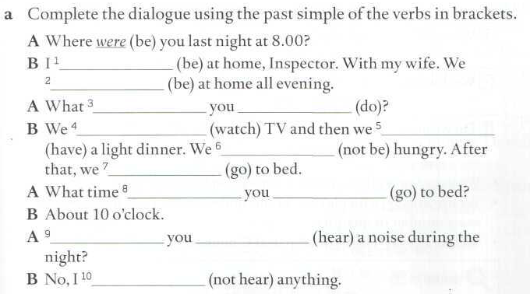
Page 139
was
were
did
do
watched
had
weren’t
went
did
go
Did
hear
didn’t hear

Slide 22
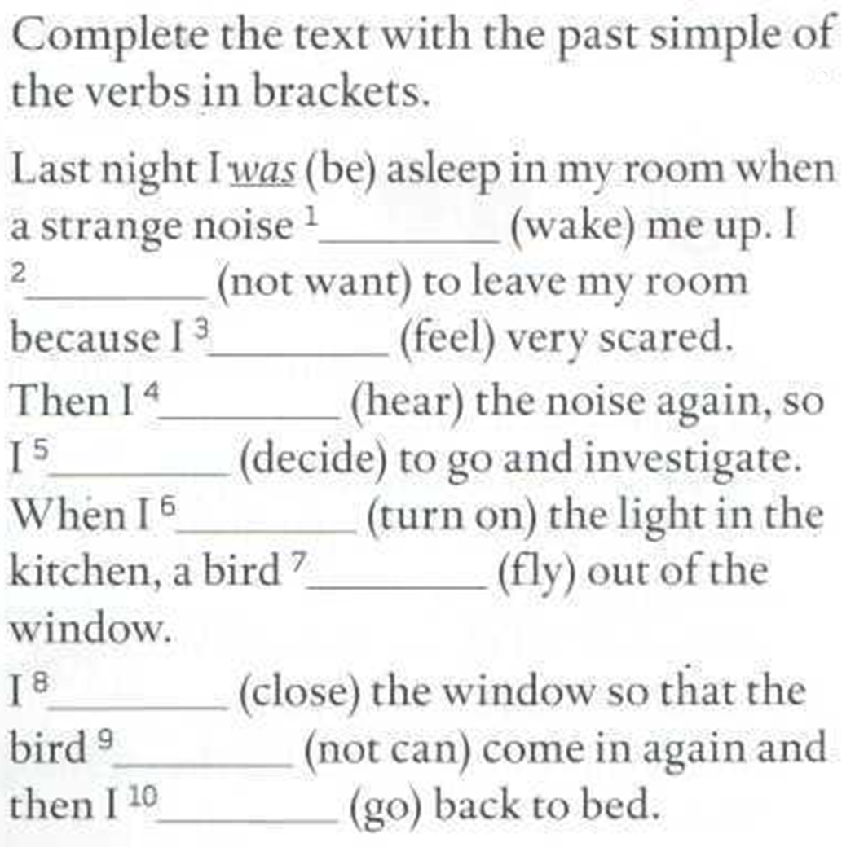
139 Memorize and say
woke
didn’t want
felt
heard
decided
turned on
flew
closed
couldn’t
went

Slide 23
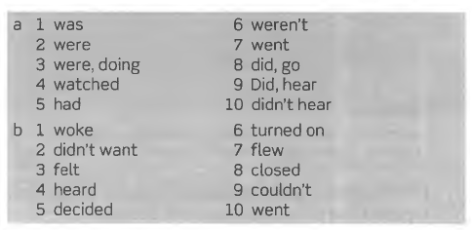
Key to exercises page 139

Slide 24
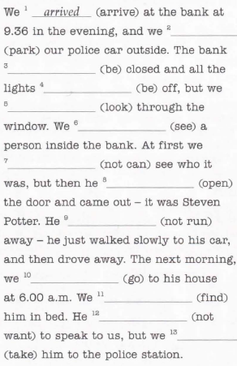
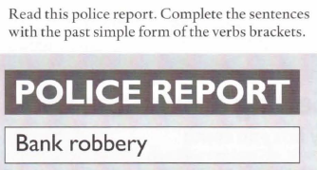
WB 50
parked
was
were
looked
saw
couldn’t
opened
didn’t run
went
found
didn’t want
took

Slide 25
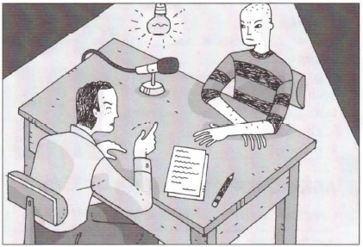
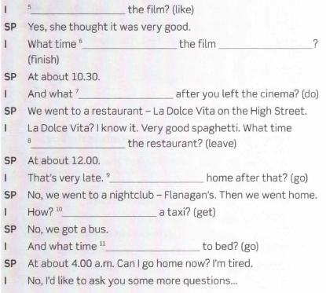
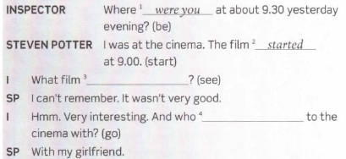
Did she like
did
finish
did you do
did you leave
Did you go
Did you get
did you see
did you go
did you go

Slide 26
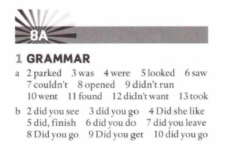

Slide 27
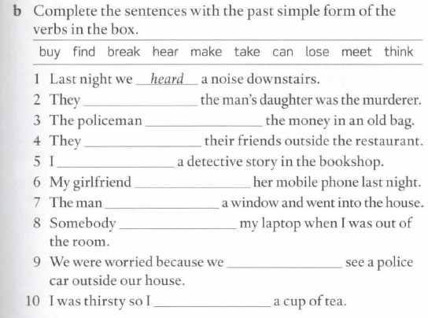
WB PAGE 51
thought
found
met
bought
lost
broke
took
could
made

Slide 28
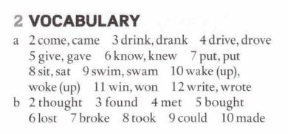
Key to exercises a) and b) page 51 (workbook)

Slide 29
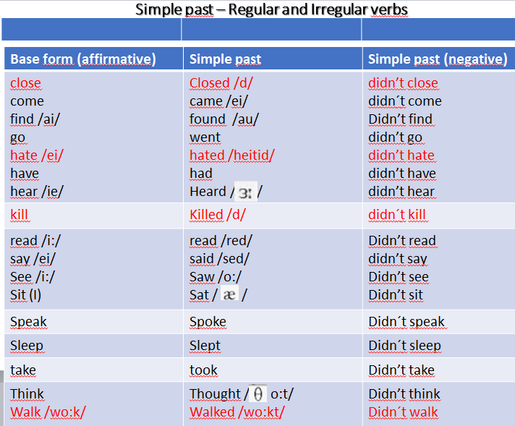

Slide 30
Simple past – Regular and Irregular verbs
Base form (affirmative) | Simple past | Simple past (negative)
come | came | Didn´t come
Kill | Killed | Didn´t kill
Close | Closed | Didn´t close
Speak | Spoke | Didn´t speak
Sleep | Slept | Didn´t sleep
Sit | Sat | Didn´t sit
Hate Walk | hated Walked | Didn´t hate Didn´t walk
Memorize the chart. Cover the second and the third columns and say the past form and the past negative of these verbs

Slide 31
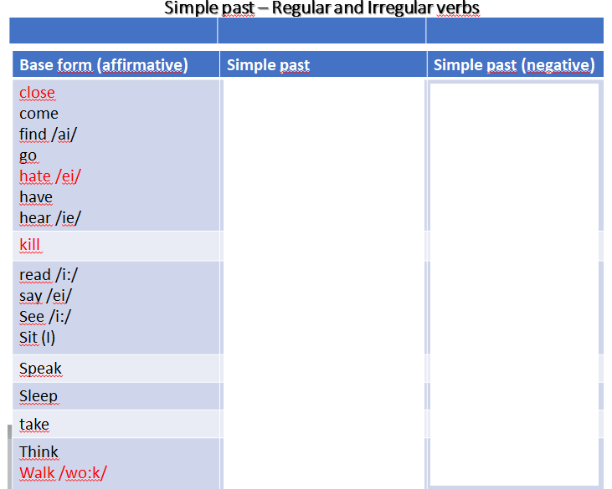

Slide 32
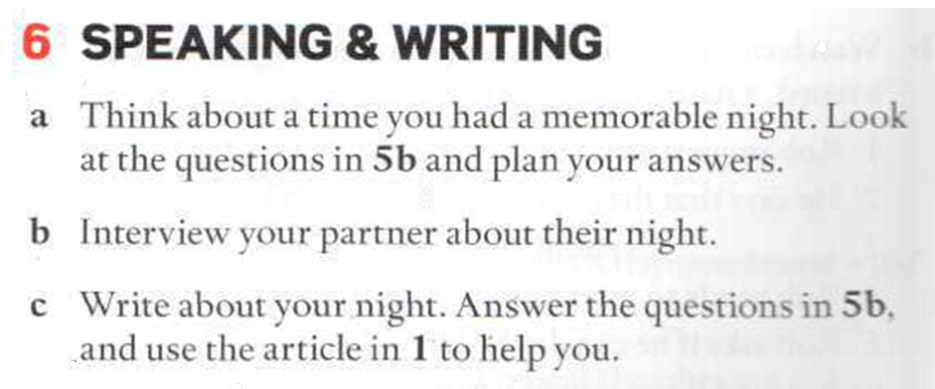

Slide 33
https://elt.oup.com/student/englishfile/elementary3/grammar/file07/?cc=ar&selLanguage=en
Choose a file and an exercise above, or choose an exercise below.
Lesson A past simple of be: was / were (1)
Lesson A past simple of be: was / were (2)
Lesson B past simple regular verbs (1)
Lesson B past simple regular verbs (2)
Lesson C past simple irregular verbs (1)
Lesson C past simple irregular verbs (2)

